Slide 1
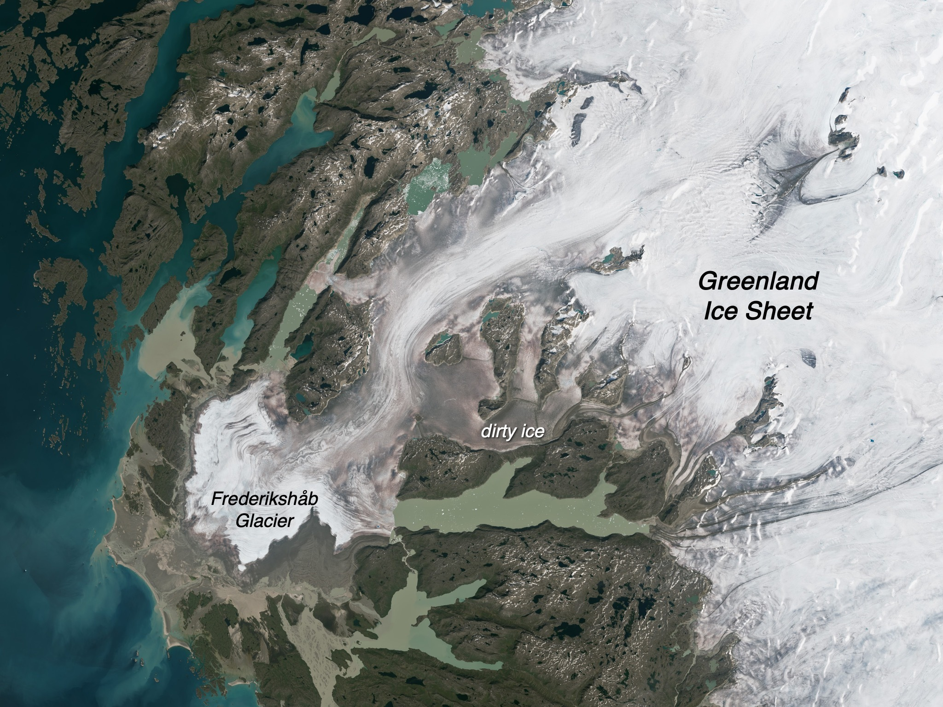

EXPLORING THE ROLE OF ARTIFICIAL INTELLIGENCE IN COMBATING CLIMATE CHANGE
Presented By:
SHAHINA NAAZ KHAN
A354145022013
MCA III
2023-2024

Slide 2

HOW ARTIFICIAL INTELLIGENCE IS COMBATING CLIMATE CHANGE?
By providing methods that are useful for research, engineering, and policy for both mitigation and adaptation.
Rising global temperatures are attributed to the greenhouse effect and human activities. AI can analyze vast amounts of data to identify trends and patterns, providing insights crucial for mitigation strategies.
It has the ability to stop preventable warming and lessen the effects of unavoidable warming.
AI technologies such as machine learning and predictive analytics can optimize energy usage, improve weather forecasting, and enhance resource management. These applications have the potential to significantly reduce carbon emissions.

Slide 3

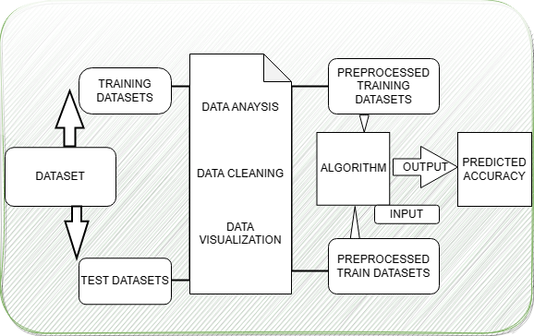
RESEARCH METHODOLOGY
We have used Linear Regression, Decision Tree Regression, Random Forest and LSTM algorithm for predicting temperature.
We have taken datasets which contains the factors which affect the climate which include temperature, emission of carbon dioxide, nitrous oxide, methane gas, warming of the ocean and variations of sea level.
We have used RMSE method to compare the result of the above data.
System Architecture Diagram

Slide 4
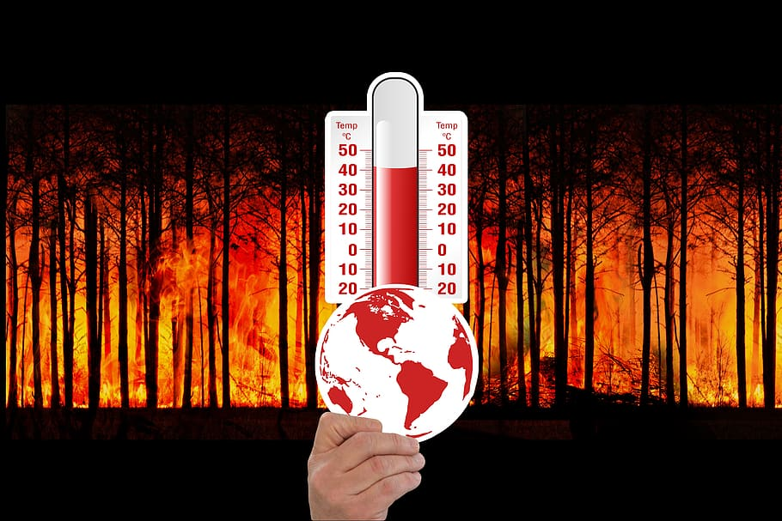
RESULT
The graph shows the comparison of the outputs gained after executing each model as the results show that LSTM provides more accuracy in the dataset and is more suitable for providing accurate outputs.

Slide 5

CONCLUSION
After researching on this topic of role of AI in combating climate change, I came to the conclusion that LSTM is best method for predicting temperature. Regarding climate action and whether the world can escape extremely harmful climate change, the next ten years will be crucial.
Harnessing the power of AI is essential for addressing the challenges of climate change. By leveraging AI for monitoring, optimization, and adaptation, we can create a sustainable future and combat the environmental crisis effectively.

Slide 6
REFERENCES
[1], “Artificial Intelligence and Climate Change Opportunities, considerations, and policy levers to align AI with climate change goals” by LYNN H. KAACK, PRIYA L. DONTI, EMMA STRUBELL, DAVID ROLNICK
[2], “Temperature Prediction Using Various Machine Learning Algorithms” [1] Shasanka Roy, [2] Dr. Pramod Kumar Maurya School of Computer Science & Engineering, Vellore Institute of Technology
[3], “The AI gambit: leveraging artificial intelligence to combat climate change—opportunities, challenges, and recommendations” Josh Cowls1,2 · Andreas Tsamados1 Mariarosaria Taddeo, Luciano Floridi
[4], “THE ROLE OF ARTIFICIAL INTELLIGENCE IN CLIMATE CHANGE MITIGATION AND ADAPTATION Thesis in Artificial Intelligence” Abu Rayhan and Shahana Rayhan

Slide 7

THANK YOU

